Slide 1
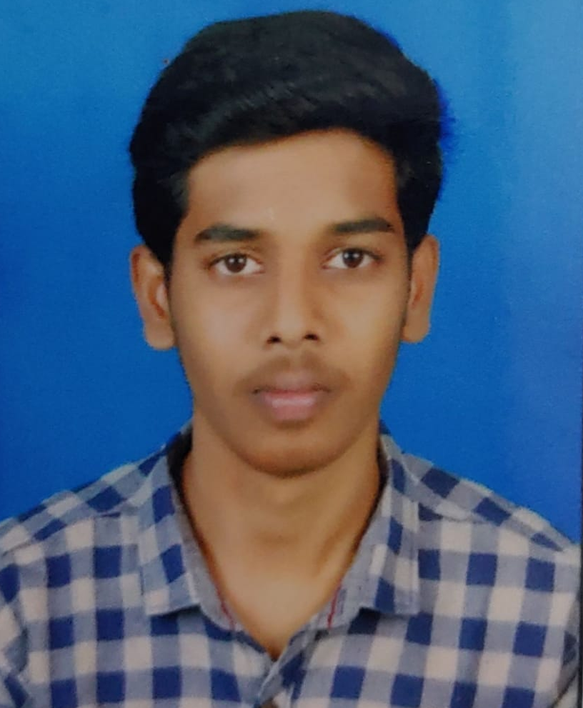
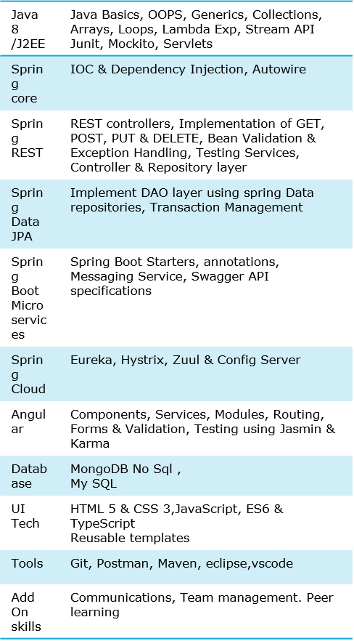



PULLAKANDAM SAIKUMAR
Analyst/Software Engineer
Bachelor of Engineering
Computer Science : 2018 - 2021
Skills
Hyderabad
SAIKUMARPULLAKANDAM@CAPGEMINI.COM
+91 7815835335
A4
Full Stack Developer
Hands on experience in creating microservices with Spring boot, Spring Security, Spring Cloud API Gateway, Eureka server, resilience 4J, load balancing.
Proficient in creating Single page Web Application in Angular with Authentication with Angular reactive forms, angular routing
experience in creating documentation with Java docs and swagger and in unit testing using Junit, Mockito including code quality compliance using Sonar cube.
Development experience in creating docker images and pushing to Docker Hub with containerized applications using Docker SWARM
Experience in integrating Angular with spring boot and connecting spring boot to MongoDB
In-depth understanding of deploying spring boot applications in AWS Cloud environment
Online-Hotel Management System
Completed end to end case study of Online Hotel Management Application along with JWT authentication, Swagger Material-UI and Angular Bootstrap used for user interface.
Check out my work on GitHub & Video

